Slide 1
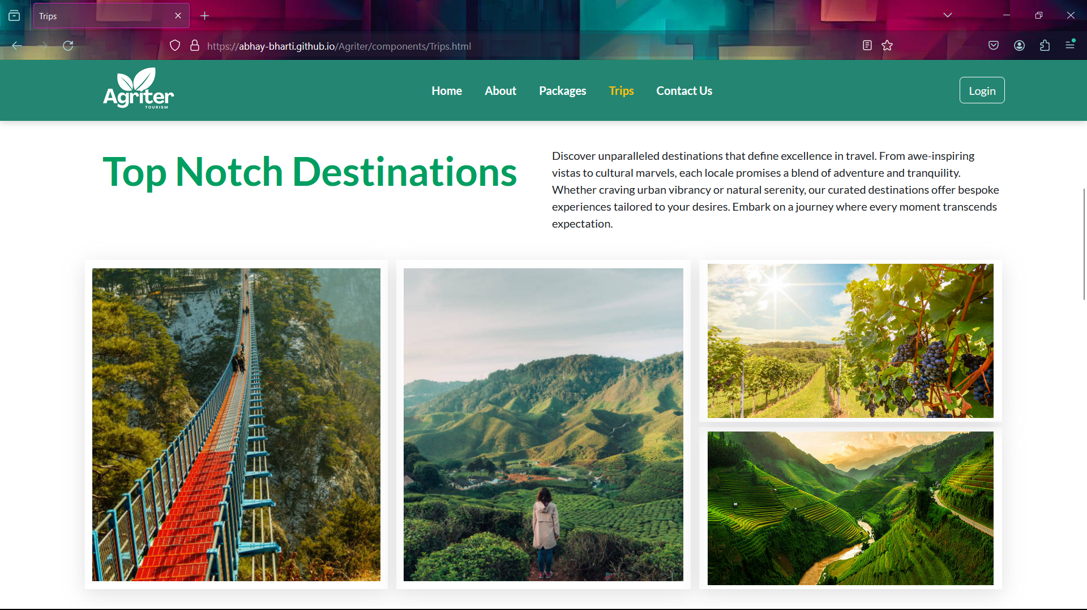
Introduction to the Agri-Tourism Website
My Company Name :- Agriter
Agri Stands for Agriculture
ter stands for Journey
Welcome to Agriter, your digital doorway to the enchanting world of agri-tourism. Dive into a cornucopia of experiences, from farm stays to vineyard tours, where you can immerse yourself in the rhythms of rural life and savor the authentic flavors of the countryside. Join us as we cultivate connections between travelers and the agricultural wonders that abound.

Slide 2
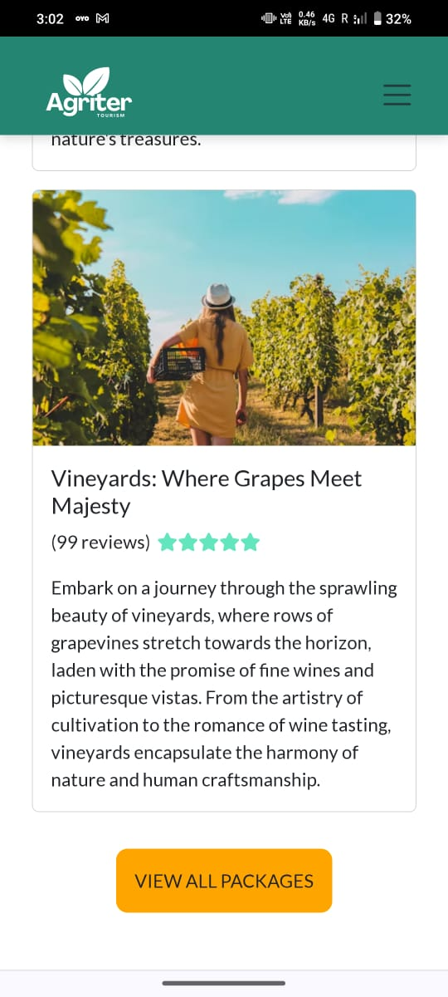
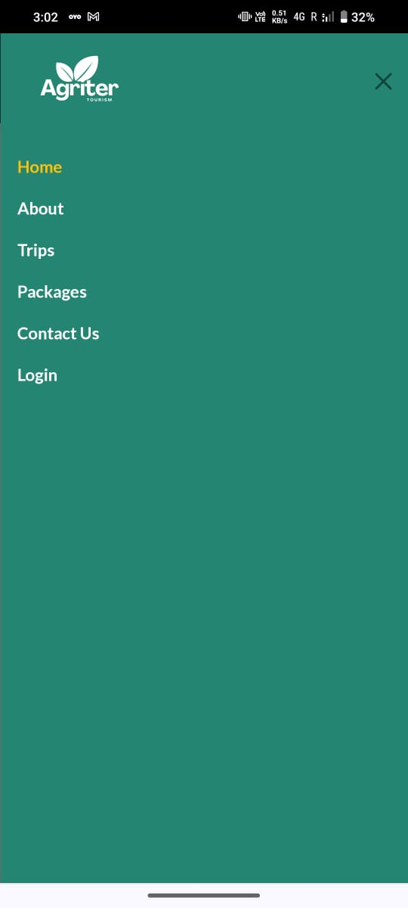
Home Page
This is a responsive design of the website.
Features:-
Responsive Cards
When a website is scrolled till 40px transparent navbar becomes green.
When your screen shrinks to less than 992 pixels wide, bam! The navbar transforms into a sleek sidebar. It's like magic! From there, you can easily hop around to different pages. It's all about keeping things smooth and accessible, no matter the screen size.

Slide 3
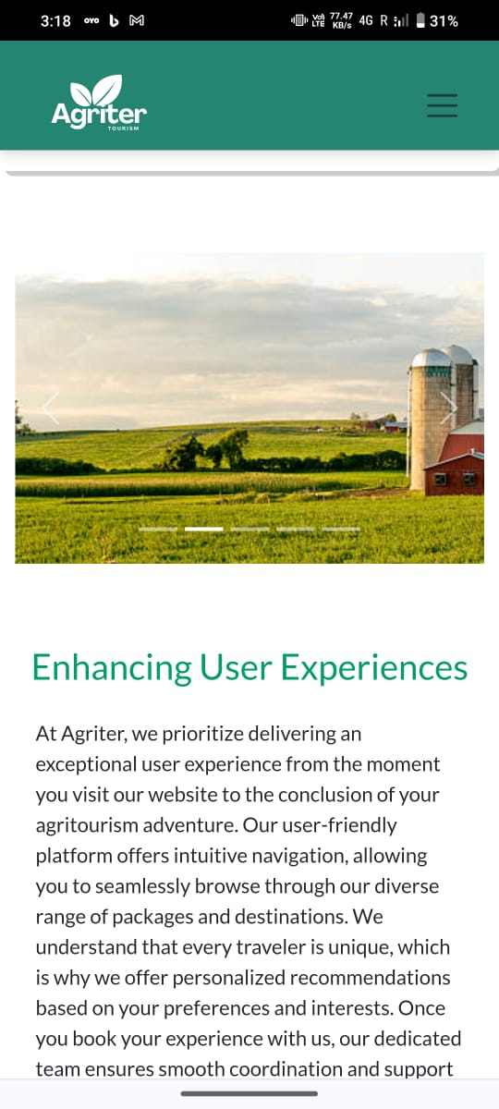
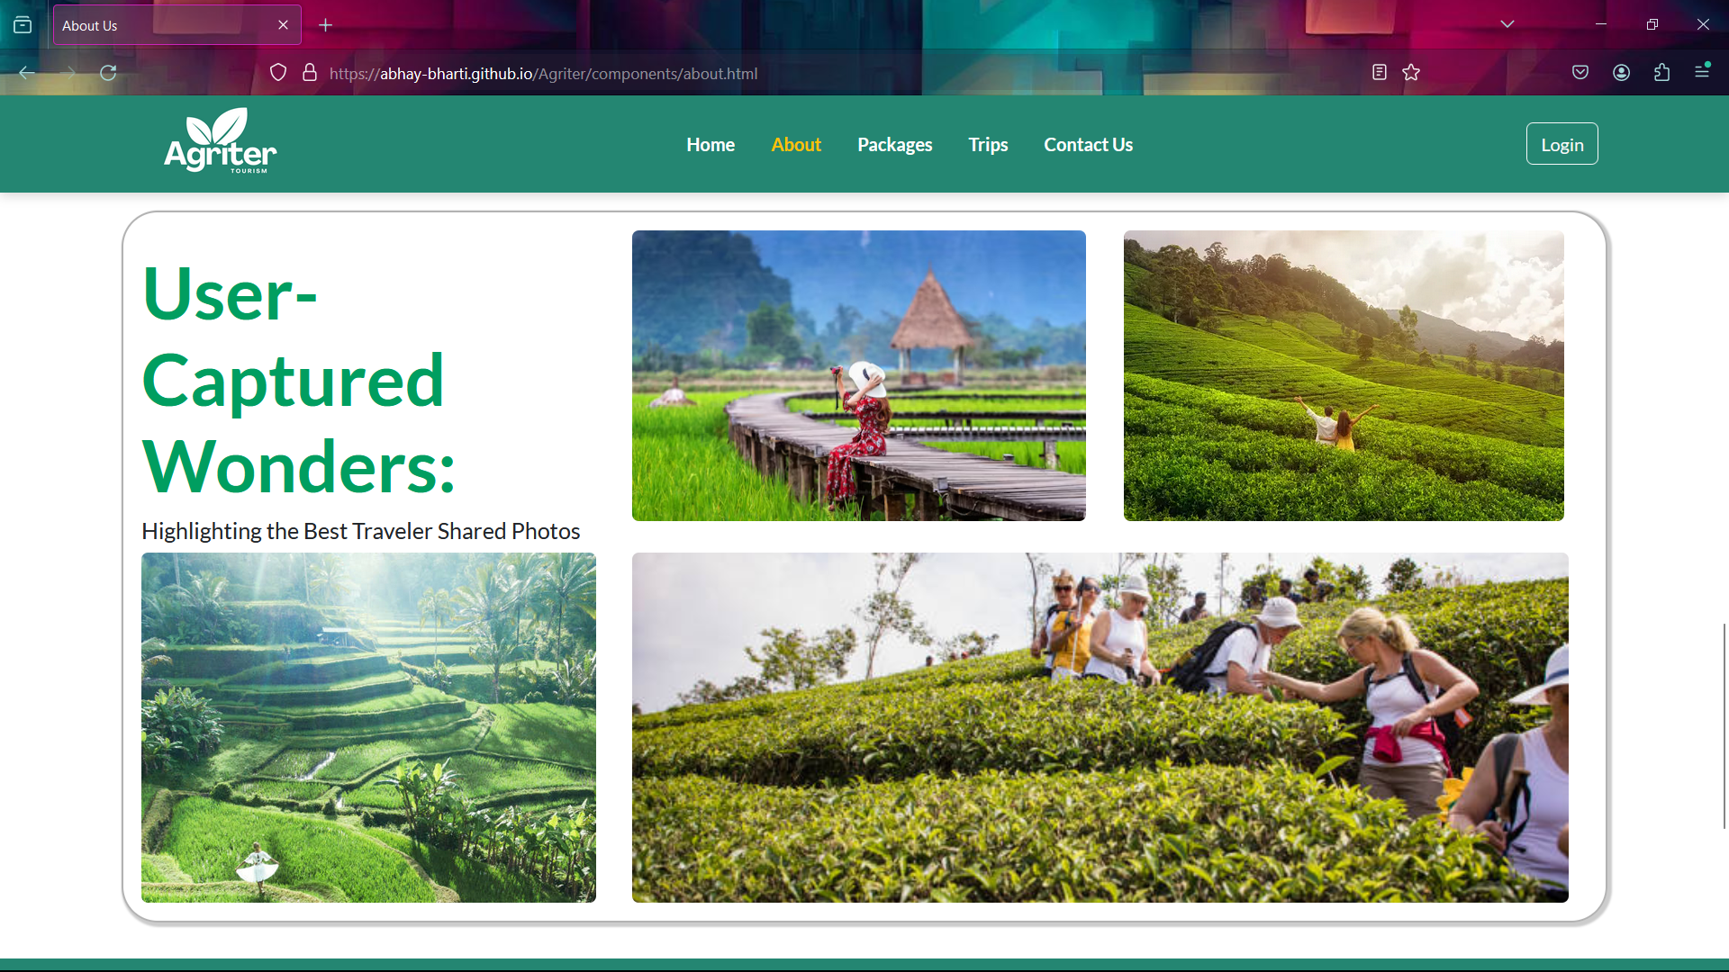
About Us Page
Features in About us Page:
- Dynamic image slider powered by Bootstrap Carousel
- Seamlessly showcases our journey and story
- Engaging photo gallery utilizing Bootstrap Grid

Slide 4
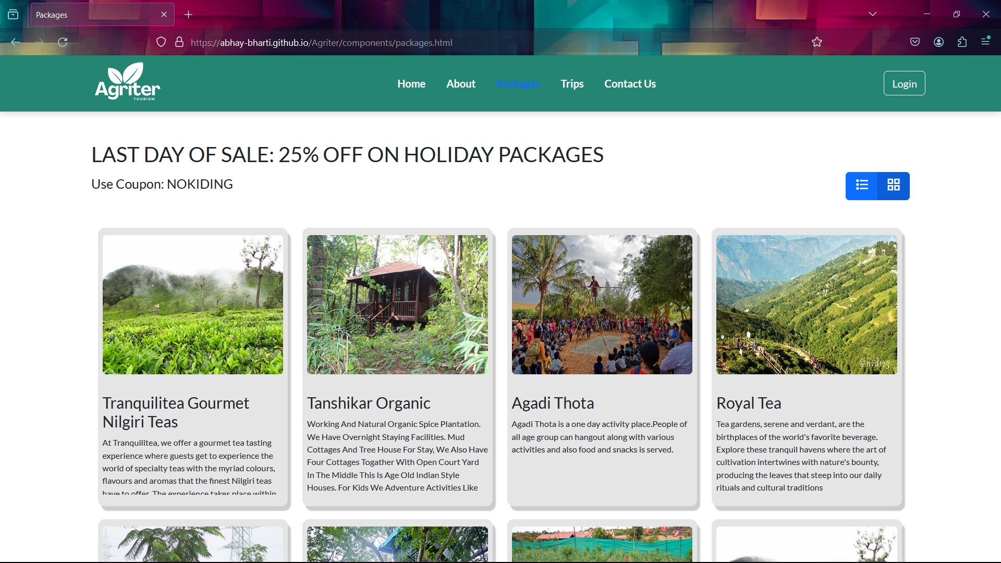
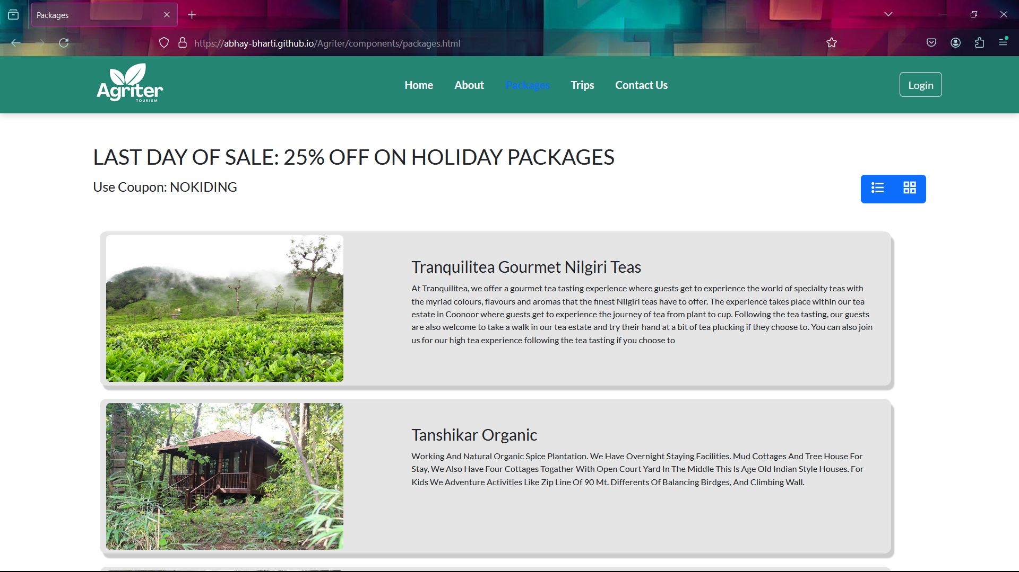
Packages Page
Our Packages page offers a versatile browsing experience with both list and grid view options. Whether you prefer a streamlined list format for quick comparisons or an immersive grid layout for visual exploration, we cater to your preferences. Discover our diverse range of offerings effortlessly, from essential packages to premium selections, all presented in a user-friendly interface. With the ability to toggle between views, finding the perfect package to suit your needs has never been easier. Explore at your own pace, and let our Packages page be your gateway to exceptional experiences.
Features :-
Background Image Slider
The Packages cards can be viewed in list and grid manner, Grid view is default , once list button is clicked cards will appear in list manner and if grid button is clicked cards will apperar in grid manner.

Slide 5
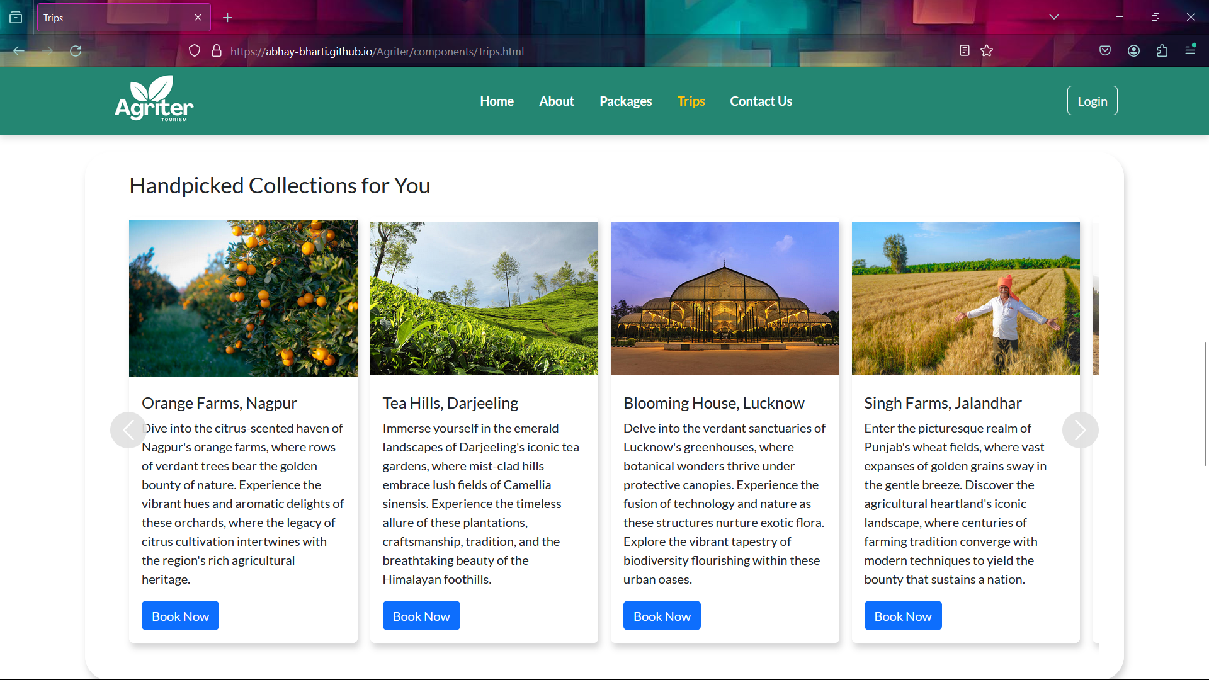
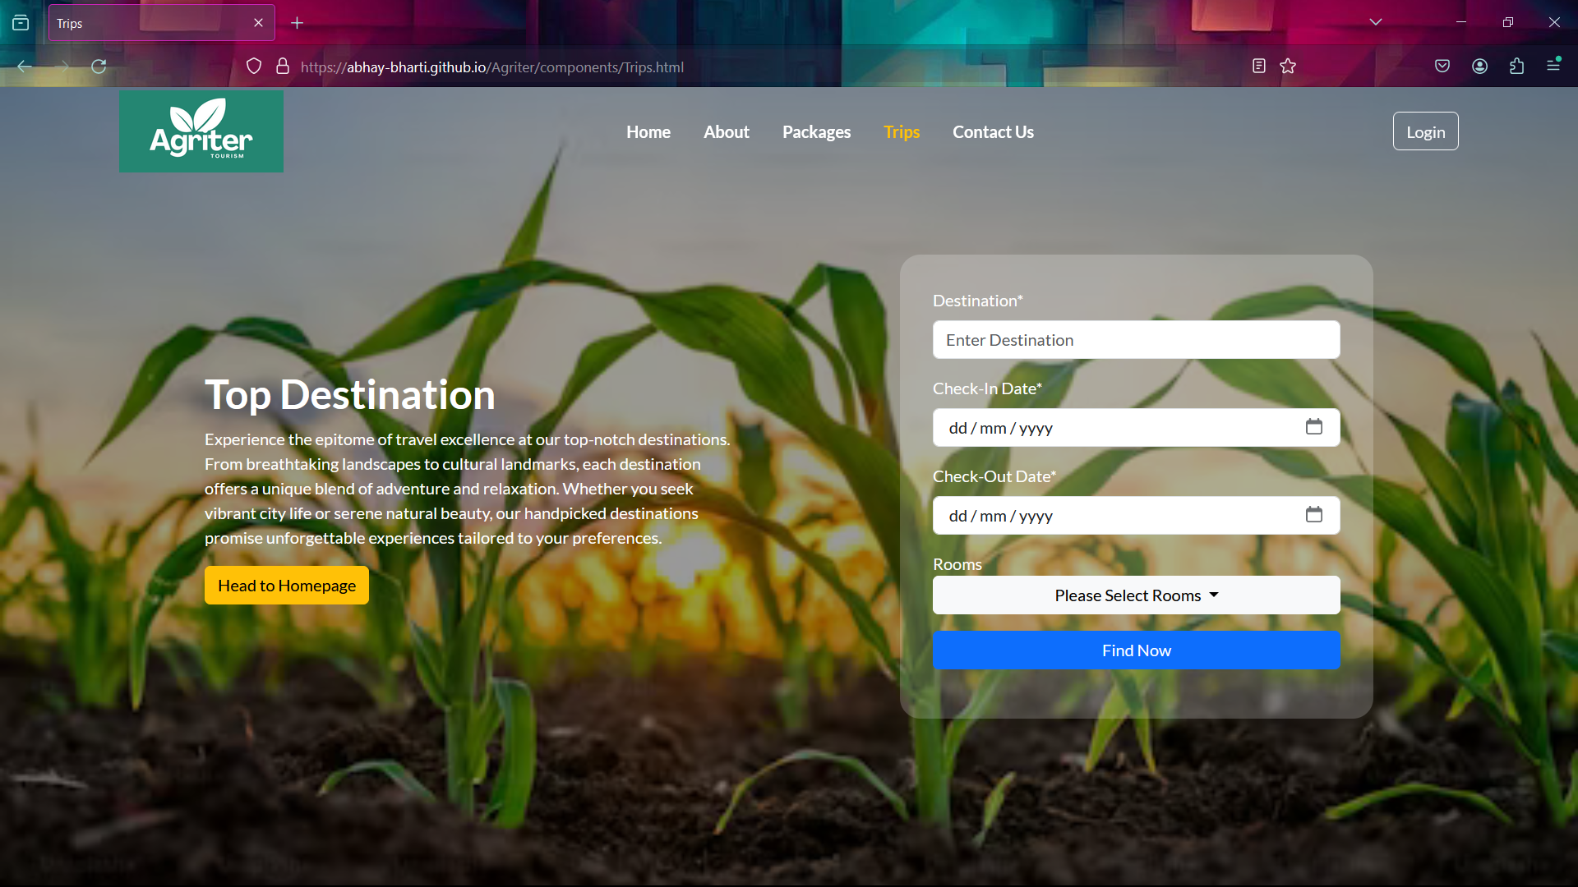
Trips Page
This Page contains Trips information in cards.
This Card Bar is slidable Carousel.
This is achieved by using Jquery Code.
This Page also contains a form to enter
Destination Name
Check-In Date
Check-Out Date
Number of Peoples to stay

Slide 6
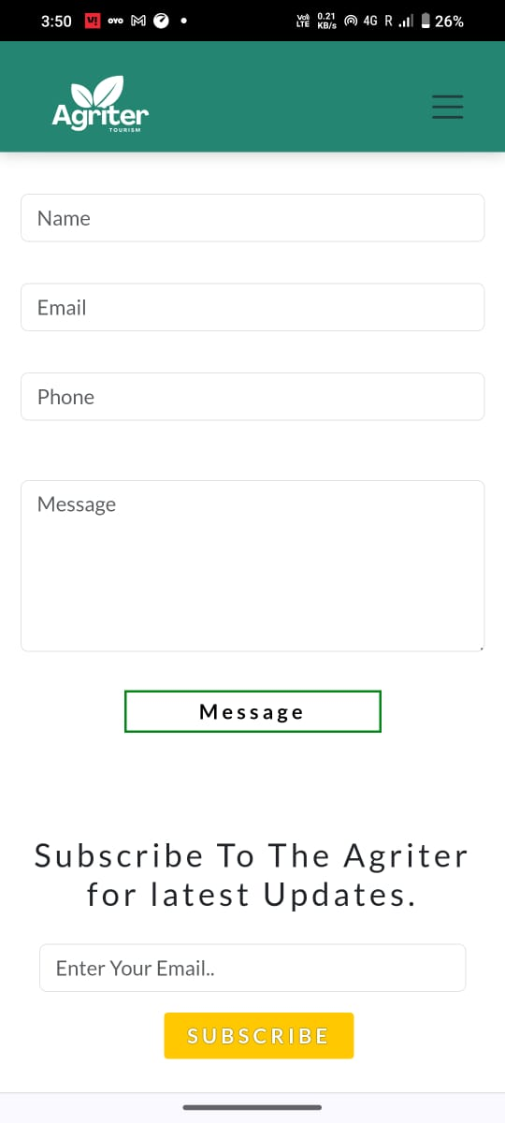
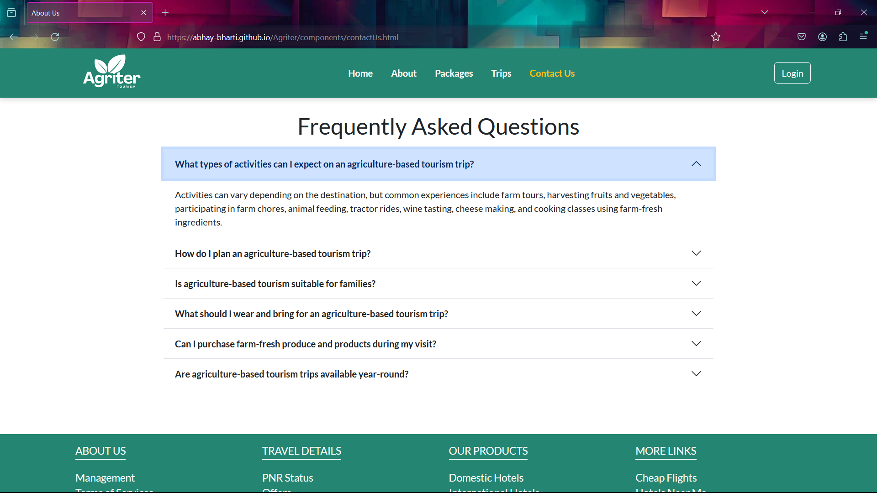
Contact Us Page
Form to enter name, email, phone, and query
Our contact page makes it easy for customers to reach out with inquiries, feedback, or booking requests. Visitors can fill out a simple form to share their information and message, or find our contact details like email and phone number.
The FAQ Section is Created by using Bootstrap Accordion
Accordion.
Bootstrap Accordion - Vertically collapsing accordions in combination with Collapse JavaScript plugin.

Slide 7
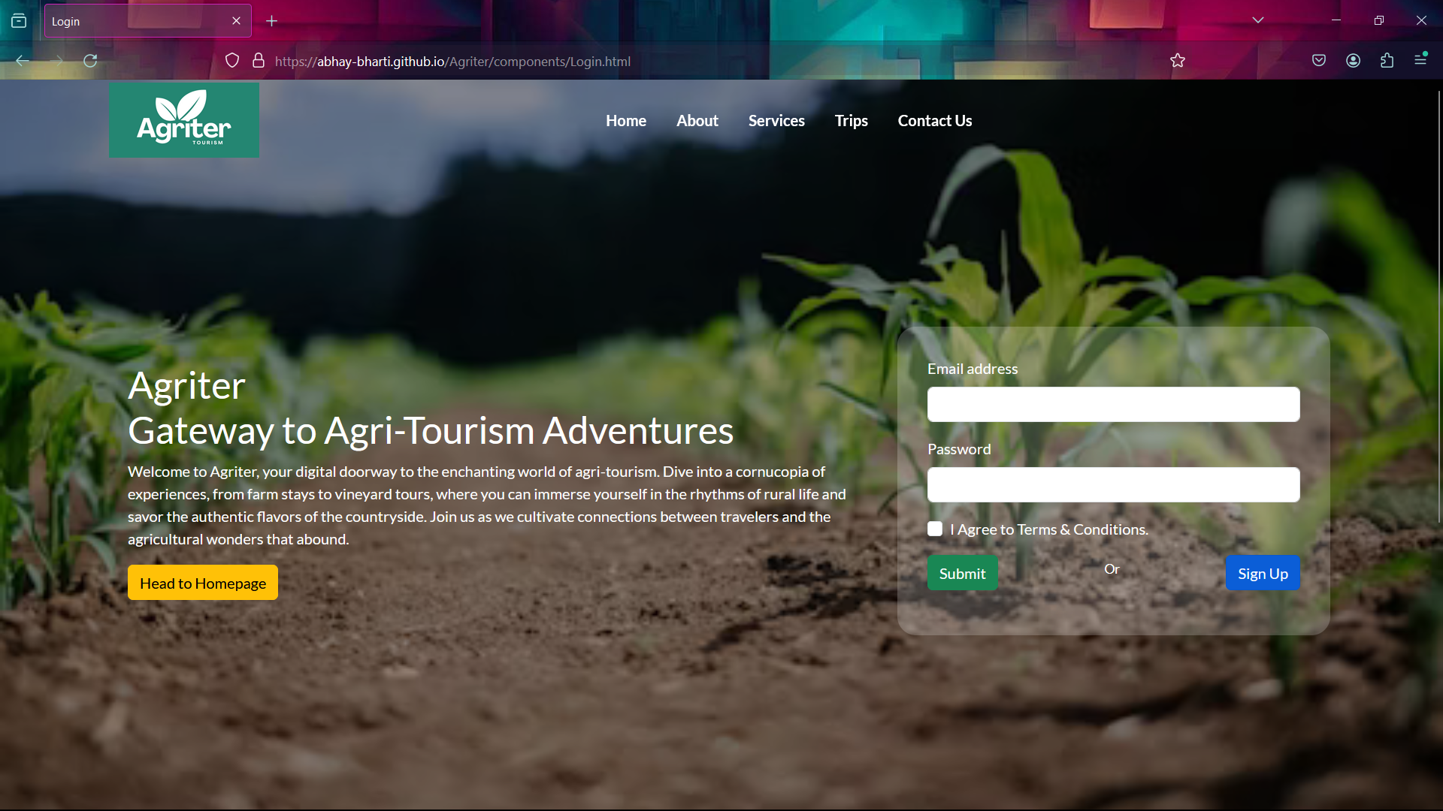
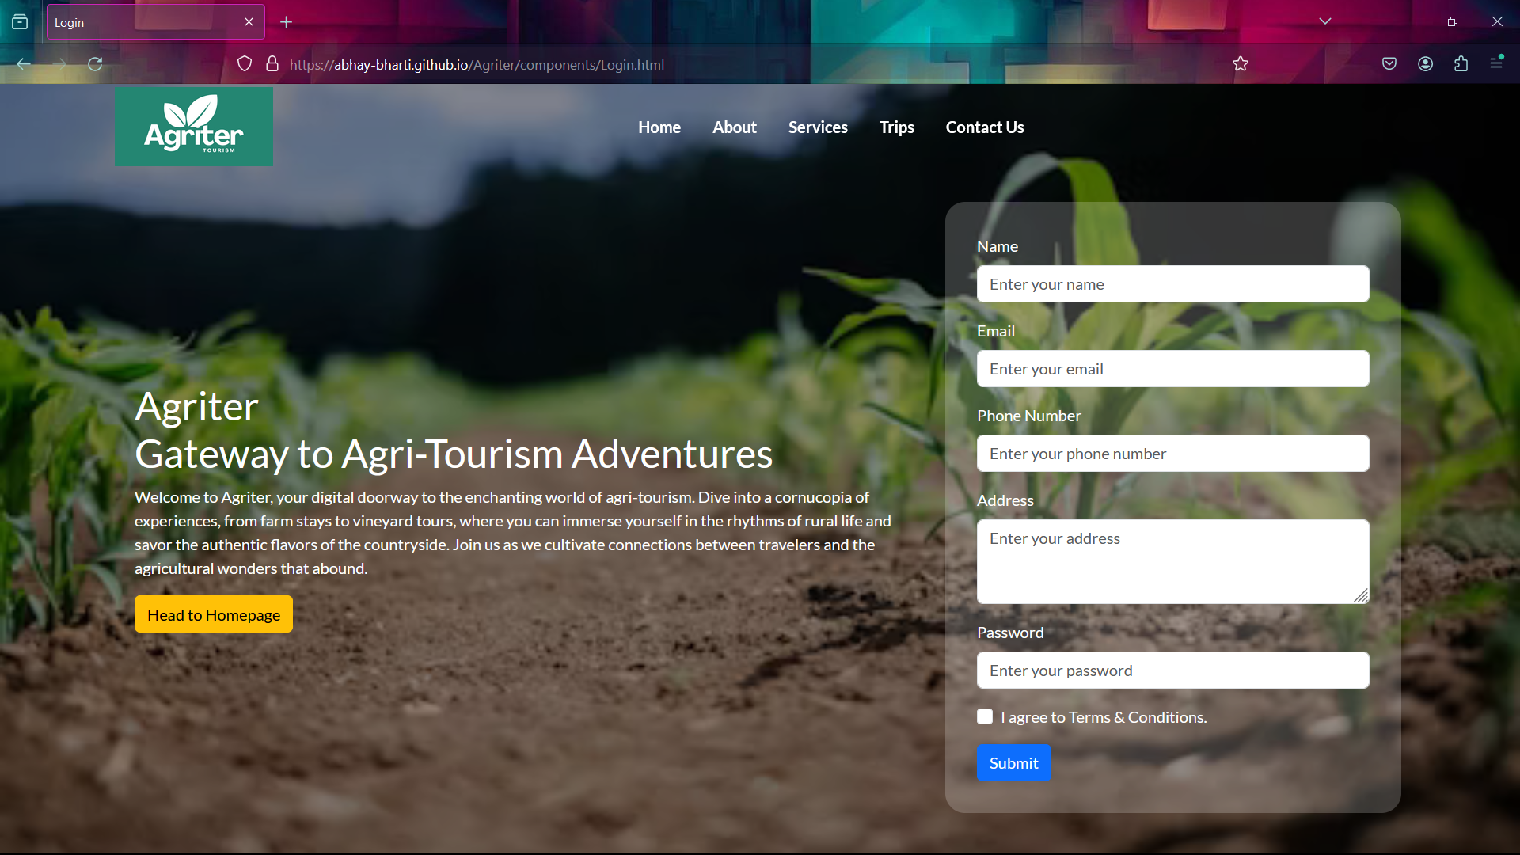

Login Page
Secure login to access your personalized account on our travel tourism website. Enter your credentials to view your booking details, update your profile, and explore new trip packages tailored to your preferences.
Features:-
On entering login details it will redirect to home page using form action.
If user wants to sign-up he/she can click on sign-up button the login section will disappear using hide function and sign-up form will appear using show function after 2 seconds.

Slide 8

Technical Stack: HTML, Angular, jQuery, CSS, JavaScript, Bootstrap
The website is built using a robust technology stack, including HTML for structuring the web pages, Angular for building a dynamic and responsive user interface, and jQuery for adding interactivity and animations.
The visual styling is handled with CSS, while JavaScript is used for client-side scripting and enhancing the user experience.
To ensure a modern and visually appealing design, the website leverages the Bootstrap framework, which provides a wide range of pre-designed components and responsive layout tools.

Slide 9



Key Features for Best User Experience
Responsive Design
Attractive
Design
Regular Updates
Seamless Booking
Ensure the website is optimized for seamless viewing and navigation across all devices - from desktops to smartphones - providing a consistent and user-friendly experience.
Sleek, modern design with intuitive navigation, captivating visuals, and seamless functionality for an unforgettable user experience.
Regular updates ensure fresh content, improved features, and enhanced security, keeping our platform relevant, reliable, and responsive to evolving needs.
Implement a user-friendly booking engine that simplifies the process of reserving flights, accommodations, and activities, allowing customers to complete their travel plans with ease.

Slide 10

Future Plans
Expand Destinations
1
Explore new and exciting travel destinations to offer our customers an even more diverse range of experiences, from exotic tropical getaways to cultural immersions in historic cities.
2
Enhanced Online Booking
Upgrade our website and mobile app to provide a seamless, user-friendly booking process, allowing customers to easily plan and customize their dream vacations.
Personalized Recommendations
3
Leverage data and customer insights to offer personalized vacation recommendations, ensuring each traveler finds the perfect trip tailored to their interests and preferences.

Slide 11
Conclusion
1
Seamless Integration
2
Memorable Experiences
The travel tourism website seamlessly combines cutting-edge technology with a user-friendly interface, creating an exceptional experience for travelers.
By offering a diverse range of personalized trips and packages, the website ensures that each customer's journey is unique and leaves a lasting impression.
3
Continuous Improvement
4
Bright Future
The website's commitment to innovation and customer feedback will drive ongoing enhancements, ensuring it remains at the forefront of the travel tourism industry.
With a strong technical foundation and a focus on delivering exceptional value, the travel tourism website is poised for continued growth and success in the years to come.

